Slide 1
Maps & Dictionaries

Slide 2






Maps
A map models a searchable collection of
key-value entries
The main operations of a map are for searching, inserting, and deleting items
Multiple entries with the same key are not allowed

Slide 3



Dictionary
Multiple items with the same key are allowed
Applications:
word-definition pairs
credit card authorizations
DNS mapping of host names (e.g., inha.ac.kr) to internet IP addresses (e.g., 165.246.13.102)

Slide 4

Entry ADT of Map & Dictionary
An entry stores a key-value pair (k,v)
Methods:
key(): return the associated key
value(): return the associated value
setKey(k): set the key to k
setValue(v): set the value to v
4

Slide 5






The Map ADT
find(k): lookup an entry with key k
if there is an entry with key k, returns a pointer to it, else returns the special iterator end
put(k, v): insert an entry with key k and value v
erase(k): remove an entry with key k
size(), empty(), begin(), end(): other basic operations
5

Slide 6














Dictionary ADT
find(k):
put(k, v):
erase(k):
The same as Map ADT
begin(), end(), size(), empty():
findAll(k): returns pointers (or an iterator) to all entries with key k
6

Slide 7





Example of Map
Operation empty() put(5,A)
put(7,B)
put(2,C)
put(8,D)
put(2,E) find(7) find(4) find(2) size() erase(5) erase(2) find(2) empty()
Output true [(5,A)]
[(7,B)]
[(2,C)]
[(8,D)]
[(2,E)]
[(7,B)]
end [(2,E)] 4
end false
Map Ø (5,A)
(5,A),(7,B)
(5,A),(7,B),(2,C)
(5,A),(7,B),(2,C),(8,D)
(5,A),(7,B),(2,E),(8,D)
(5,A),(7,B),(2,E),(8,D)
(5,A),(7,B),(2,E),(8,D)
(5,A),(7,B),(2,E),(8,D)
(5,A),(7,B),(2,E),(8,D)
(7,B),(2,E),(8,D)
(7,B),(8,D)
(7,B),(8,D)
(7,B),(8,D)

Slide 8










A Simple List-Based Map
We can efficiently implement a map using an
unsorted list
We store the items of the map in a list S (based
on a doubly-linked list), in arbitrary order
header
nodes/positions
trailer
9 c
6 c
5 c
8 c
entries

Slide 9

















































Slide 10









Find Algorithm in List-based Map
Algorithm find(k):
for each p in [S.begin(), S.end()) do if p➔key() = k then
return p
return S.end() {there is no entry with key equal to k}

Slide 11






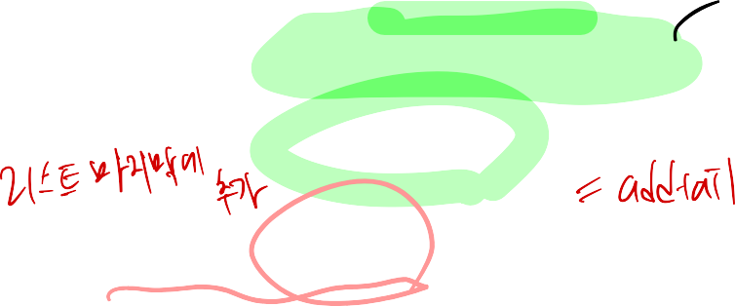



Put Algorithm in List-based Map
Algorithm put(k,v):
for each p in [S.begin(), S.end()) do if p➔key() = k then
p➔setValue(v) return p
p = S.insertBack((k,v)) {there is no entry with key k}
n = n + 1 {increment number of entries}
return p

Slide 12





Erase Algorithm in List-based Map
Algorithm erase(k):
for each p in [S.begin(), S.end()) do if p.key() = k then
S.erase(p)
n = n - 1 {decrement number of entries}

Slide 13










Performance of a List-Based Map
Performance:
put takes O(n) time since we need to determine whether it is already in the sequence
find and erase take O(n) time since in the worst case (the item is not found) we traverse the entire sequence to look for an item with the given key
The unsorted list implementation is effective only for maps of small size or for maps in which puts are the most common operations, while searches and removals are rarely performed (e.g., historical record of logins to a workstation)

Slide 14








Major Implementation
for Maps and Dictionaries
Hash Table
Only need to look up entries based on their keys
O(1) expected time for:
find, insert, delete
Although O(n) in the worst case time (still not very bad news)
Binary Search Tree
O(h) time for: (i.e., O(log n) for a balanced tree)
find, insert, delete
Not only look up values, but also find values based on their
orderings
e.g.,
find the value with the smallest key � k find the value with the largest key � k
13

